Slide 1
Role of Smoking and Cholesterol in CVD, CHD, and Stroke in the Framingham Heart Study
Nimish Adhikari, Hibiki Orui, Irene Hsueh, Hannah Park
Nimish Adhikari, Hibiki Orui, Irene Hsueh, Hannah Park
Notes:
Hannah

Slide 2


Introduction
Goal: study association between smoking, cholesterol, and heart disease
Framingham Heart Study
longitudinal prospective cohort study on etiology of cardiovascular disease
free-living subjects in Framingham, MA
established in 1948
now contains data on 3 generations of participants
Literature Review
CDC states smoking causes almost 1 in 4 deaths from cardiovascular disease
high cholesterol levels increases risk for heart disease
Age, sex, family history of heart disease, obesity, diabetes, unhealthy diet, clinical depression also contribute to heart disease

Slide 3

Dataset
4,434 unique participants between 32-70 years old
3 follow-up periods
only baseline data from first exam was used
Outcomes of interest: Incidence and Time To
cardiovascular disease (CVD) (includes CHD & stroke)
coronary heart disease (CHD)
stroke

Slide 4
Explanatory Variables
Quantitative Variables
age
systolic blood pressure (mmHg)
diastolic blood pressure (mmHg)
number of cigarettes smoked per day
serum total cholesterol (mg/dL)
Binary Yes/No Variables
use of antihypertensive medication
current smoker
diabetes (serum glucose of over 200 mg/dL)
Categorical Variables
cigarette category
0 cigarettes
1-10 cigarettes
11-20 cigarettes
21+ cigarettes
sex
Male
Female
high-density lipoprotein cholesterol (mg/dL),
low-density lipoprotein cholesterol (mg/dL)
BMI (kg/m²)
serum glucose (mg/dL)
heart rate (beats per minute)
cholesterol category
<200 mg/dL
200-219 mg/dL
220-259 mg/dL
260+ mg/dL
Notes:
Category cutoffs are from previous studies

Slide 5
Descriptive Characteristics
Table 1: Baseline Characteristics of the Framingham Dataset
 | Male n=1,944 43.84% | Female n=2,490 56.16% | Total (n=4,434) | p-value
Age (mean, SD) | 49.79 (8.72) | 50.03 (8.64) | 49.93 (8.68) | 0.3450
Systolic BP (mean, SD) | 131.74 (19.44) | 133.82 (24.46) | 132.91 (22.42) | 0.0016
Diastolic BP (mean, SD) | 83.71 (11.44) | 82.60 (12.50) | 83.08 (12.06) | 0.0020
Use of BP Meds (n,%)
No BP Meds | 1,880 (97.81%) | 2,349 (95.84%) | 4,229 (96.71%) | 0.0003
BP Meds | 42 (2.19%) | 102 (4.16%) | 144 (3.29%)
Heart Rate (mean, SD) | 74.40 (11.90) | 77.06 (12.15) | 75.89 (12.11) | <0.0001
Total Cholesterol (mean, SD) | 233.58 (42.36) | 239.68 (46.22) | 236.98 (44.65) | <0.0001
Cholesterol Category (n,%)
<200 | 392 (20.16%) | 530 (21.29%) | 922 (20.79%) | <0.001
200 - 219 | 364 (18.72%) | 369 (14.82%) | 733 (16.53%)
220 - 259 | 710 (36.52%) | 817 (32.81%) | 1,527 (34.44%)
260+ | 478 (24.59%) | 774 (31.08%) | 1,252 (28.24%)
Notes:
Hannah

Slide 6
Descriptive Characteristics (cont.)
 | Male n=1,944 43.84% | Female n=2,490 56.16% | Total (n=4,434) | p-value
Smoking Status (n,%)
Not Smokers | 769 (39.56%) | 1483 (59.56%) | 4,229 (96.71%) | <0.0001
Smokers | 1,175 (60.44%) | 1006 (40.40%) | 144 (3.29%)
Cigarettes Per Day (mean, SD) | 13.23 (13.78) | 5.65 (8.96) | 8.97 (11.93) | <0.0001
Cigarette Category (n, %)
0 Cigarettes | 769 (39.89%) | 1,484 (59.98%) | 2,253 (51.18%) | <0.0001
1-10 Cigarettes | 195 (10.11%) | 460 (18.59%) | 655 (14.88%)
11-20 Cigarettes | 583 (30.24%) | 433 (17.50%) | 1016 (23.08%)
21+ Cigarettes | 381 (19.76%) | 97 ( 3.92%) | 478 (10.86%)
BMI (mean, SD) | 26.17 (3.41) | 25.59 (4.56) | 25.85 (4.10) | <0.0001
Serum Glucose (mean, SD) | 82.32 (24.72) | 82.07 (24.14) | 82.19 (24.40) | 0.7468
Diabetes (n,%)
No Diabetes | 1,885 (96.97%) | 2,428 (97.51%) | 4,313 (97.27%) | 0.269
Diabetes | 59 (3.03%) | 62 (2.49%) | 121 (2.73%)

Slide 7
Descriptive Characteristics (cont.)
 | Male n=1,944 43.84% | Female n=2,490 56.16% | Total (n=4,434) | p-value
Cardiovascular Disease (n,%)
No CVD | 1,258 (64.71%) | 2,019 (81.08%) | 3,277 (73.91%) | <0.0001
CVD | 686 (35.29%) | 471 (18.92%) | 1,157 (26.09%)
Coronary Heart Disease (n,%)
No CHD | 1,234 (63.48%) | 1,960 (78.71%) | 3,194 (72.03%) | <0.0001
CHD | 710 (36.52%) | 530 (21.29%) | 1,240 (27.97%)
Stroke (n,%)
No Stroke | 1,751 (90.07%) | 2,268 (91.08%) | 4,019 (90.64%) | 0.2508
Stroke | 193 (9.93%) | 222 (8.92%) | 415 (9.36%)
Days to CVD (mean, SD) | 6,273.70 (3,015.18) | 7242.86 (2,549.01) | 6,817.95 (2,804.32) | <0.0001
Days to CHD (mean, SD) | 6,155.88 (3,066.85) | 7064.61 (2,656.32) | 6,666.20 (2,878.82) | <0.0001
Days to Stroke (mean, SD) | 7,003.43 (2,509.10) | 7539.78 (2,262.43) | 7,304.63 (2,388.34) | <0.0001
Notes:
Hannah

Slide 8
Methods
Cox proportional hazards models used to model survival time to CVD, CHD, and stroke
zph tests using Schoenfeld residuals used to check proportional hazards assumption
model fit determined using Schwarz Information Criterion (SBC)
Previous studies adjusted for
1) age 6) BP Meds
2) sex 7) smoking
3) total cholesterol 8) diabetes
4) SBP 9) HDL
5) BMI
LDL and HDL not provided in first exam, so the other 8 covariates were added to the model
Notes:
Nimish

Slide 9
Model Selection - Step 1
cholesterol and smoking as continuous or categorical variables
Model | Covariates | SBC Values
 |  | CVD | CHD | Stroke
A1 | Cholesterol Category, Smoking Status, Sex, Age, SBP, BP_Meds, Diabetes, BMI | 17614.792 | 19070.508 | 6240.337
A2 | Total Cholesterol, Smoking Status, Sex, Age, SBP, BP_Meds, Diabetes, BMI | 17395.850 | 18798.445 | 6171.734
A3 | Cholesterol Category, Cigarettes, Sex, Age, SBP, BP_Meds, Diabetes, BMI | 17438.741 | 18884.722 | 6198.189
A4 | Total Cholesterol, Cigarettes, Sex, Age, SBP, BP_Meds, Diabetes, BMI | 17218.240 | 18611.223 | 6129.658
A5 | Cholesterol Category, Cigarette Category, Sex, Age, SBP, BP_Meds, Diabetes, BMI | 17432.678 | 18883.124 | 6196.626
A6 | Total Cholesterol, Cigarette Category, Sex, Age, SBP, BP_Meds, Diabetes, BMI | 17221.371 | 18623.770 | 6129.222
Notes:
cholesterol was coded as numeric, smoking coded as categorical because cigarettes per day violated proportional hazards assumption
Model A6 had pretty low SBC values

Slide 10
Model Selection - Step 2
Total Cholesterol, Cigarette Category, Sex, Age, SBP, BP_Meds, Diabetes, BMI | 17221.371 | 18623.770 | 6129.222
include all covariates SBP, BP meds, diabetes, BMI
Model | Covariates | SBC Values
 |  | CVD | CHD | Stroke
B1 | Total Cholesterol, Cigarette Category, Sex, Age, SBP, Diabetes, BMI | 17561.616 | 19022.870 | 6239.411
B2 | Total Cholesterol, Cigarette Category, Sex, Age, BP_Meds, Diabetes, BMI | 17323.587 | 18683.627 | 6189.006
B3 | Total Cholesterol, Cigarette Category, Sex, Age, SBP, BP_Meds, BMI | 17248.935 | 18636.664 | 6138.645
B4 | Total Cholesterol, Cigarette Category, Sex, Age, SBP, BP_Meds, Diabetes | 17323.721 | 18720.604 | 6174.435
B5 | Total Cholesterol, Cigarette Category, Sex, Age, SBP, BP_Meds | 17354.297 | 18736.694 | 6184.307
B6 | Total Cholesterol, Cigarette Category, Sex, Age, SBP | 17692.309 | 19135.546 | 6292.885
B7 | Total Cholesterol, Cigarette Category, Sex, Age, BP_Meds | 17498.227 | 18832.719 | 6259.920
B8 | Total Cholesterol, Cigarette Category, Sex, Age, Diabetes, BMI | 17686.540 | 19099.878 | 6321.740
B9 | Total Cholesterol, Cigarette Category, Sex, Age, Diabetes | 17823.262 | 19230.967 | 6382.562
B10 | Total Cholesterol, Cigarette Category, Sex, Age, BMI | 17719.230 | 19117.457 | 6331.885
B11 | Total Cholesterol, Cigarette Category, Sex, Age | 17865.377 | 19256.106 | 6396.214
Notes:
dropping variables didn’t improve model fit compared to best model from first step

Slide 11
Model Selection - Step 3
logarithmically transformed continuous variables
Model | Covariates | SBC Values
 |  | CVD | CHD | Stroke
C | Log Total Cholesterol, Cigarette Category, Sex, Log Age, Log SBP, BP_Meds, Diabetes, Log BMI | 17222.656 | 18624.123 | 6127.548
Total Cholesterol, Cigarette Category, Sex, Age, SBP, BP_Meds, Diabetes, BMI | 17221.371 | 18623.770 | 6129.222
Notes:
logarithmic transformation of continuous variables would only improve model fit for stroke but would make interpretation a lot harder

Slide 12
Model Selection - Step 4
Total Cholesterol, Cigarette Category, Sex, Age, SBP, BP_Meds, Diabetes, BMI | 17221.371 | 18623.770 | 6129.222
interaction terms with age and sex
Model | Covariates | SBC Values
 |  | CVD | CHD | Stroke
D1 | Total Cholesterol, Cigarette Category, Sex, Age, SBP, BP_Meds, Diabetes, BMI, total_chol*age | 17218.851 | 18623.479 | 6132.931
D2 | Total Cholesterol, Cigarette Category, Sex, Age, SBP, BP_Meds, Diabetes, BMI, total_chol*sex | 17227.769 | 18630.692 | 6131.973
D3 | Total Cholesterol, Cigarette Category, Sex, Age, SBP, BP_Meds, Diabetes, BMI, cigarette_cat*age | 17234.640 | 18641.426 | 6140.327
D4 | Total Cholesterol, Cigarette Category, Sex, Age, SBP, BP_Meds, Diabetes, BMI, cigarette_cat*sex | 17239.428 | 18644.196 | 6145.981
D5 | Total Cholesterol, Cigarette Category, Sex, Age, SBP, BP_Meds, Diabetes, BMI, sbp*age | 17227.997 | 18630.819 | 6134.558
D6 | Total Cholesterol, Cigarette Category, Sex, Age, SBP, BP_Meds, Diabetes, BMI, sbp*sex | 17228.365 | 18630.168 | 6135.025
D7 | Total Cholesterol, Cigarette Category, Sex, Age, SBP, BP_Meds, Diabetes, BMI, diabetes*age | 17225.991 | 18627.899 | 6132.961
D8 | Total Cholesterol, Cigarette Category, Sex, Age, SBP, BP_Meds, Diabetes, BMI, diabetes*sex | 17227.538 | 18630.565 | 6134.421
D9 | Total Cholesterol, Cigarette Category, Sex, Age, SBP, BP_Meds, Diabetes, BMI, bmi*age | 17227.970 | 18628.161 | 6135.194
D10 | Total Cholesterol, Cigarette Category, Sex, Age, SBP, BP_Meds, Diabetes, BMI, bmi*sex | 17228.303 | 18630.830 | 6135.090
D11 | Total Cholesterol, Cigarette Category, Sex, Age, SBP, BP_Meds, Diabetes, BMI, total_chol*cigarette_cat | 17240.466 | 18644.435 | 6150.721
Notes:
adding interaction terms didn’t improve the performance of all 3 models and would have made interpretation more complicated

Slide 13
Model Selection - Step 5
sex-stratified analysis
Variable | Males | Hazard Ratio | 95% Confidence Interval | Females | Hazard Ratio | 95% Confidence Interval
Total Cholesterol | CVD | 1.003 | 1.002-1.005 | CVD | 1.002 | 1.000-1.005
1-10 Cigarettes |  | 1.185 | 0.908-1.545 |  | 1.252 | 0.966-1.621
11-20 Cigarettes |  | 1.375 | 1.137-1.663 |  | 1.833 | 1.422-2.363
21+ Cigarettes |  | 1.361 | 1.090-1.698 |  | 1.386 | 0.789-2.436
Total Cholesterol | CHD | 1.004 | 1.003-1.006 | CHD | 1.005 | 1.003-1.007
1-10 Cigarettes |  | 1.105 | 0.849-1.438 |  | 1.049 | 0.818-1.344
11-20 Cigarettes |  | 1.246 | 1.032-1.504 |  | 1.204 | 0.933-1.555
21+ Cigarettes |  | 1.353 | 1.094-1.673 |  | 1.044 | 0.607-1.794
Total Cholesterol | Stroke | 1.001 | 0.997-1.004 | Stroke | 0.996 | 0.996-1.000
1-10 Cigarettes |  | 1.144 | 0.697-1.877 |  | 1.271 | 0.863-1.873
11-20 Cigarettes |  | 1.725 | 1.226-2.426 |  | 2.104 | 1.463-3.024
21+ Cigarettes |  | 1.150 | 0.728-1.815 |  | 1.202 | 0.488-2.962
Notes:
from descriptive statistics, most variables were not evenly distributed between sexes
95% confidence intervals for each sex were very close, so we didn’t stratify by sex

Slide 14
Final Cox Proportional Hazards Model
Total Cholesterol
Cigarette Category reference = 0 cigarettes
0 cigarettes
1-10 cigarettes
11-20 cigarettes
21+ cigarettes
Sex reference = females
Age
SBP
BP Meds reference = no BP Meds
Diabetes reference = no diabetes
BMI
Covariates | SBC Values
 | CVD | CHD | Stroke
Total Cholesterol, Cigarette Category, Sex, Age, SBP, BP_Meds, Diabetes, BMI | 17221.371 | 18623.770 | 6129.222
If model selection is an art, then this is our masterpiece.
Notes:
Nimish

Slide 15
CVD Analysis
For each 1 unit increase in mg/dL of total cholesterol, hazard of CVD increased 1.003 times
Compared to nonsmokers, hazard of CVD increased
1.218 times for 1-10 cigarettes
1.517 times for 11-20 cigarettes
1.417 times for 21+ cigarettes
Males had 2.425 times the hazard of CVD compared to females
For each additional year older a subject was, hazard of CVD increased 1.060 times
For each 1 unit increase in mmHg of SBP, hazard of CVD increased 1.015 times
People taking BP meds had 1.436 times the hazard of CVD compared to those not taking BP meds
Subjects with diabetes had 2.272 times the hazard of CVD compared to those without diabetes
For each 1 unit increase in kg/m² of BMI, hazard of CVD increased 1.028 times
Proportional hazard regression coefficients for CVD
Variable | Parameter Estimate | Hazard Ratio | 95% Hazard Ratio Confidence Interval | zph test p-value | p-value
Total Cholesterol | 0.00306 | 1.003 | 1.002-1.004 | 0.0907 | <0.0001
1-10 Cigarettes | 0.19715 | 1.218 | 1.013-1.465 | 0.0737 | 0.0363
11-20 Cigarettes | 0.41644 | 1.517 | 1.302-1.766 | 0.8954 | <.0001
21+ Cigarettes | 0.34842 | 1.417 | 1.159-1.728 | 0.4318 | 0.0007
Sex (Male) | 0.88603 | 2.425 | 2.128-2.765 | 0.1703 | <0.0001
Age | 0.05847 | 1.060 | 1.052-1.069 | 0.0543 | <0.0001
Systolic Blood Pressure | 0.01533 | 1.015 | 1.013-1.018 | 0.5499 | <0.0001
BP Meds | 0.36172 | 1.436 | 1.103-1.868 | 0.1807 | 0.0071
Diabetes | 0.82074 | 2.272 | 1.777-2.906 | 0.0513 | <0.0001
BMI | 0.02754 | 1.028 | 1.013-1.043 | 0.8981 | 0.0003
Notes:
Hibiki

Slide 16
CHD Analysis
For each 1 unit increase in mg/dL of total cholesterol, hazard of CHD increased 1.004 times
Compared to nonsmokers, hazard of CHD increased
1.077 times for 1-10 cigarettes
1.231 times for 11-20 cigarettes
1.309 times for 21+ cigarettes
Males had 2.176 times the hazard of CHD compared to females
For each additional year older a subject was, hazard of CHD increased 1.012 times
For each 1 unit increase in mmHg of SBP, hazard of CHD increased 1.012 times
People taking BP meds had 1.428 times the hazard of CHD compared to those not taking BP meds
Subjects with diabetes had 1.903 times the hazard of CHD compared to those without diabetes
For each 1 unit increase in kg/m² of BMI, hazard of CHD increased 1.037 times
Proportional hazard regression coefficients for CHD
Variable | Parameter Estimate | Hazard Ratio | 95% Hazard Ratio Confidence Interval | zph test p-value | p-value
Total Cholesterol | 0.00424 | 1.004 | 1.003-1.005 | 0.9061 | <.0001
1-10 Cigarettes | 0.07421 | 1.077 | 0.900-1.289 | 0.3348 | 0.4184
11-20 Cigarettes | 0.20775 | 1.231 | 1.060-1.430 | 0.0772 | 0.0065
21+ Cigarettes | 0.26895 | 1.309 | 1.081-1.584 | 0.1531 | 0.0058
Sex (Male) | 0.77762 | 2.176 | 1.922-2.464 | 0.1452 | <0.0001
Age | 0.04513 | 1.046 | 1.038-1.054 | <0.0001 | <0.0001
Systolic Blood Pressure | 0.01177 | 1.012 | 1.009-1.015 | 0.4850 | <0.0001
BP Meds | 0.35662 | 1.428 | 1.105-1.846 | 0.4430 | 0.0065
Diabetes | 0.64325 | 1.903 | 1.469-2.464 | 0.0547 | <0.0001
BMI | 0.03603 | 1.037 | 1.022-1.052 | 0.7864 | <0.0001
Notes:
Hibiki

Slide 17
Stroke Analysis
For each 1 unit increase in mg/dL of total cholesterol, hazard of stroke decreased by a factor of 0.998
Compared to nonsmokers, hazard of stroke increased
1.241 times for 1-10 cigarettes
1.867 times for 11-20 cigarettes
1.209 times for 21+ cigarettes
Males had 1.448 times the hazard of stroke compared to females
For each additional year older a subject was, hazard of stroke increased 1.089 times
For each 1 unit increase in mmHg of SBP, hazard of stroke increased 1.019 times
People taking BP meds had 2.063 times the hazard of stroke compared to those not taking BP meds
Subjects with diabetes had 2.412 times the hazard of stroke compared to those without diabetes
For each 1 unit increase in kg/m² of BMI, hazard of stroke increased 1.017 times
Proportional hazard regression coefficients for Stroke
Variable | Parameter Estimate | Hazard Ratio | 95% Hazard Ratio Confidence Interval | zph test p-value | p-value
Total Cholesterol | -0.00213 | 0.998 | 0.996-1.000 | 0.5234 | 0.0764
1-10 Cigarettes | 0.21597 | 1.241 | 0.915-1.683 | 0.2316 | 0.1646
11-20 Cigarettes | 0.62455 | 1.867 | 1.456-2.396 | 0.7705 | <0.0001
21+ Cigarettes | 0.19017 | 1.209 | 0.812-1.800 | 0.5039 | 0.3489
Sex (Male) | 0.37031 | 1.448 | 1.166-1.799 | 0.5493 | 0.0008
Age | 0.08563 | 1.089 | 1.075-1.104 | 0.0202 | <0.0001
Systolic Blood Pressure | 0.01889 | 1.019 | 1.015-1.024 | 0.0870 | <0.0001
BP Meds | 0.72410 | 2.063 | 1.448-2.938 | 0.3536 | <0.0001
Diabetes | 0.88064 | 2.412 | 1.629-3.572 | 0.5560 | <0.0001
BMI | 0.01663 | 1.017 | 0.993-1.041 | 0.3227 | 0.1626
Notes:
Hibiki

Slide 18
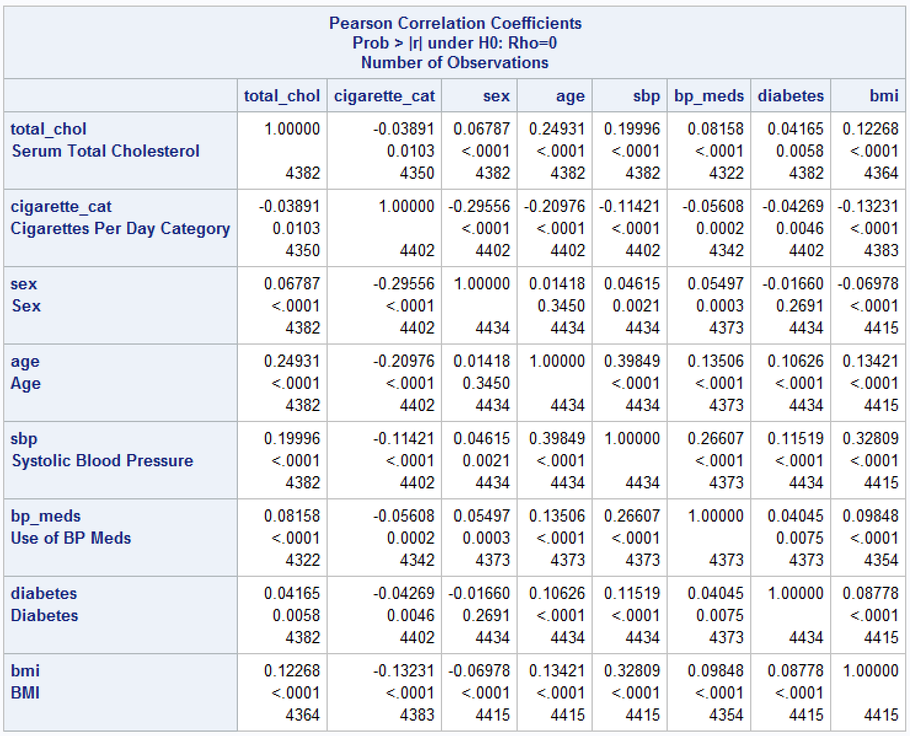
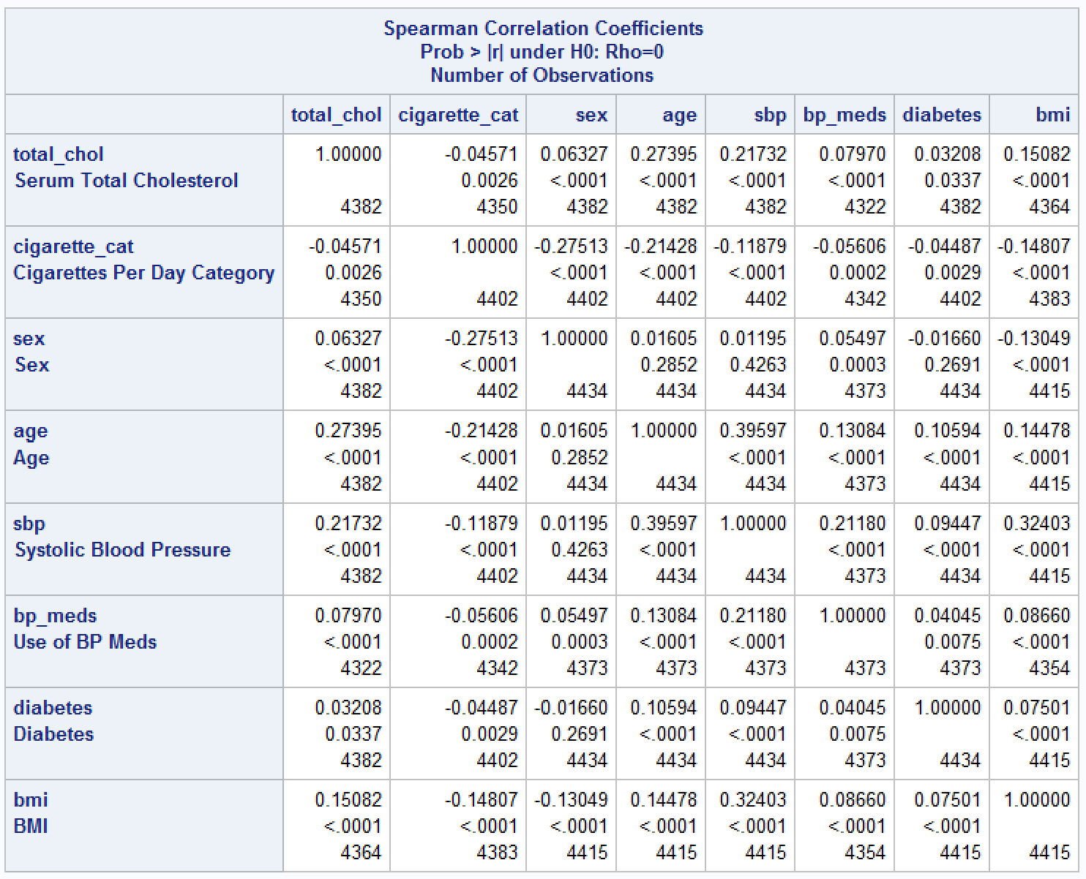
Checking Collinearity
Notes:
Collinearity happens when variables in the model are highly correlated with each other so the predictors can’t independently predict the outcome. No one wants that, so we generated Pearson and Spearman correlation coefficients, as you can see in these two tables. The largest coefficients were between SBP and age, and SBP and BMI. The p-value tells us that the linear relationships between these two pairs are significant. But, the correlation coefficients are below 0.4, so any linear relationships would be considered weak so we kept all the covariates.
We also ran a stepwise regression and it told us that all 8 predictors should be included in the final model. So I am confident that our model is a masterpiece.

Slide 19
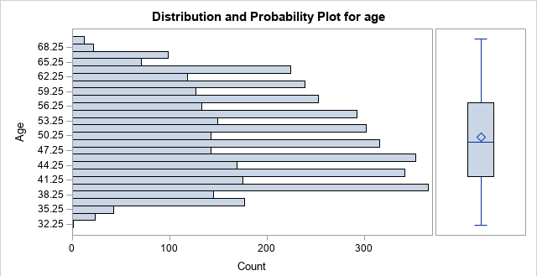
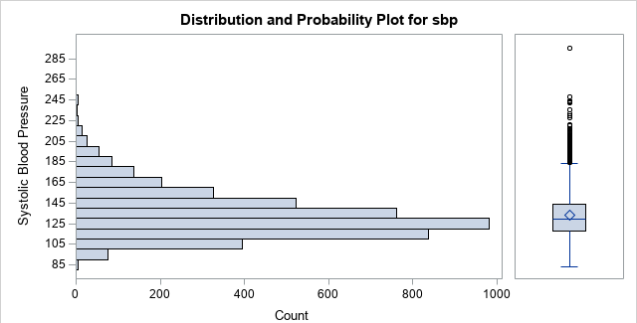
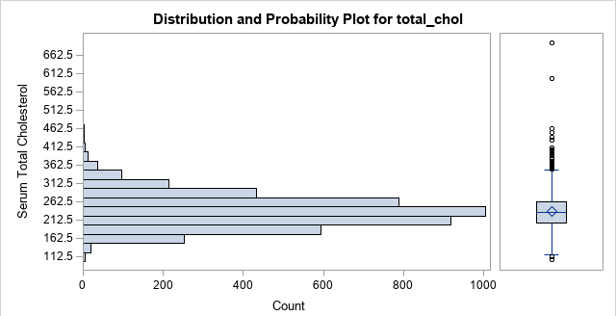
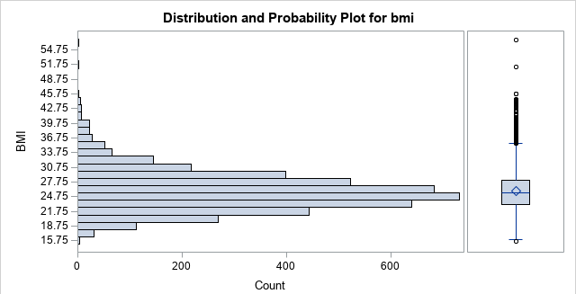
Outliers
0 outliers
150 outliers
threshold of 183.75 mmHg
large sample size of 4,434
<3% observations being outliers won’t impact distribution meaningfully
115 outliers
threshold of 331 mg/dL
1 outlier below threshold of 15.59 kg/m²
103 outliers above threshold of 35.59 kg/m²

Slide 20
CVD Discussion
Proportional hazard regression coefficients for CVD
Variable | Parameter Estimate | Hazard Ratio | 95% Hazard Ratio Confidence Interval | zph test p-value | p-value
Total Cholesterol | 0.00306 | 1.003 | 1.002-1.004 | 0.0907 | <0.0001
1-10 Cigarettes | 0.19715 | 1.218 | 1.013-1.465 | 0.0737 | 0.0363
11-20 Cigarettes | 0.41644 | 1.517 | 1.302-1.766 | 0.8954 | <.0001
21+ Cigarettes | 0.34842 | 1.417 | 1.159-1.728 | 0.4318 | 0.0007
Sex (Male) | 0.88603 | 2.425 | 2.128-2.765 | 0.1703 | <0.0001
Age | 0.05847 | 1.060 | 1.052-1.069 | 0.0543 | <0.0001
Systolic Blood Pressure | 0.01533 | 1.015 | 1.013-1.018 | 0.5499 | <0.0001
BP Meds | 0.36172 | 1.436 | 1.103-1.868 | 0.1807 | 0.0071
Diabetes | 0.82074 | 2.272 | 1.777-2.906 | 0.0513 | <0.0001
BMI | 0.02754 | 1.028 | 1.013-1.043 | 0.8981 | 0.0003
All variables significantly associated with time to CVD
No violation of proportional hazards assumption
Estimated hazard ratio for 21+ cigarettes smaller than for 11-20 cigarettes
95% confidence intervals overlap, so no significant difference for hazard of CHD

Slide 21
CHD Discussion
Proportional hazard regression coefficients for CHD
Variable | Parameter Estimate | Hazard Ratio | 95% Hazard Ratio Confidence Interval | zph test p-value | p-value
Total Cholesterol | 0.00424 | 1.004 | 1.003-1.005 | 0.9061 | <.0001
1-10 Cigarettes | 0.07421 | 1.077 | 0.900-1.289 | 0.3348 | 0.4184
11-20 Cigarettes | 0.20775 | 1.231 | 1.060-1.430 | 0.0772 | 0.0065
21+ Cigarettes | 0.26895 | 1.309 | 1.081-1.584 | 0.1531 | 0.0058
Sex (Male) | 0.77762 | 2.176 | 1.922-2.464 | 0.1452 | <0.0001
Age | 0.04513 | 1.046 | 1.038-1.054 | <0.0001 | <0.0001
Systolic Blood Pressure | 0.01177 | 1.012 | 1.009-1.015 | 0.4850 | <0.0001
BP Meds | 0.35662 | 1.428 | 1.105-1.846 | 0.4430 | 0.0065
Diabetes | 0.64325 | 1.903 | 1.469-2.464 | 0.0547 | <0.0001
BMI | 0.03603 | 1.037 | 1.022-1.052 | 0.7864 | <0.0001
Smoking 1-10 cigarettes not associated with CHD
Age violated proportional hazards assumption
95% confidence intervals overlap, so no significant difference for hazard of CHD

Slide 22
Stroke Discussion
Proportional hazard regression coefficients for Stroke
Variable | Parameter Estimate | Hazard Ratio | 95% Hazard Ratio Confidence Interval | zph test p-value | p-value
Total Cholesterol | -0.00213 | 0.998 | 0.996-1.000 | 0.5234 | 0.0764
1-10 Cigarettes | 0.21597 | 1.241 | 0.915-1.683 | 0.2316 | 0.1646
11-20 Cigarettes | 0.62455 | 1.867 | 1.456-2.396 | 0.7705 | <0.0001
21+ Cigarettes | 0.19017 | 1.209 | 0.812-1.800 | 0.5039 | 0.3489
Sex (Male) | 0.37031 | 1.448 | 1.166-1.799 | 0.5493 | 0.0008
Age | 0.08563 | 1.089 | 1.075-1.104 | 0.0202 | <0.0001
Systolic Blood Pressure | 0.01889 | 1.019 | 1.015-1.024 | 0.0870 | <0.0001
BP Meds | 0.72410 | 2.063 | 1.448-2.938 | 0.3536 | <0.0001
Diabetes | 0.88064 | 2.412 | 1.629-3.572 | 0.5560 | <0.0001
BMI | 0.01663 | 1.017 | 0.993-1.041 | 0.3227 | 0.1626
Total cholesterol and smoking 1-10 cigarettes and 21+ cigarettes were not associated with time to stroke
Age violated proportional hazards assumption
Estimated hazard ratio for 21+ cigarettes smaller than for 11-20 cigarettes
95% confidence intervals overlap, so no significant difference for hazard of CHD

Slide 23
Discussion
age violated proportional hazards assumption in CHD and stroke model
violation most likely didn’t make a large difference in main parameter estimates
large sample size of 4,273 observations
age wasn’t explanatory variable of interest
stratifying age into categories still violated proportional hazards assumption
age range 32-70, so study population skewed towards older ages
not having HDL data to adjust for may decrease accuracy of models
including physical activity levels and eating habits may provide more information

Slide 24
Conclusion
CVD
hazard increased 1.003 times for every increase in mg/dL
hazard increased 1.218 times for those who smoked 1-10 cigarettes a day
hazard increased 1.517 times for those who smoked 11-20 cigarettes a day
hazard increased 1.417 times for those who smoked 21+ cigarettes a day
CHD
hazard increased 1.004 times for every increase in mg/dL
hazard increased 1.213 times for those who smoked 11-20 cigarettes a day
hazard increased 1.309 times for those who smoked 21+ cigarettes a day
Stroke
hazard increased 1.867 times for those who smoked 11-20 cigarettes a day
CVD, CHD, and stroke all significantly associated with sex, age, SBP, BP meds, and diabetes
males had >2x hazard for CVD and CHD, almost 50% increase in hazard for stroke
hazard increased for each year of age and mmHg of SBP
subjects taking BP meds had almost 50% in hazard for CVD and CHD, >2x hazard for stroke
diabetes had >2x hazard for CVD and stroke, almost 2x hazard for CHD
matches 2014 National Diabetes Statistics Report “Adults with diabetes are nearly twice as likely to die from heart disease or stroke as people without diabetes.”
A male who is a smoker with diabetes and high total cholesterol and taking blood pressure medications will have a much higher risk of heart disease.
Notes:
[2] National Centers for Disease Control and Prevention. National diabetes statistics report, 2014. https://www.cdc.gov/diabetes/data/statistics/statistics-report.html External link. Accessed December 22, 2016.

Slide 25
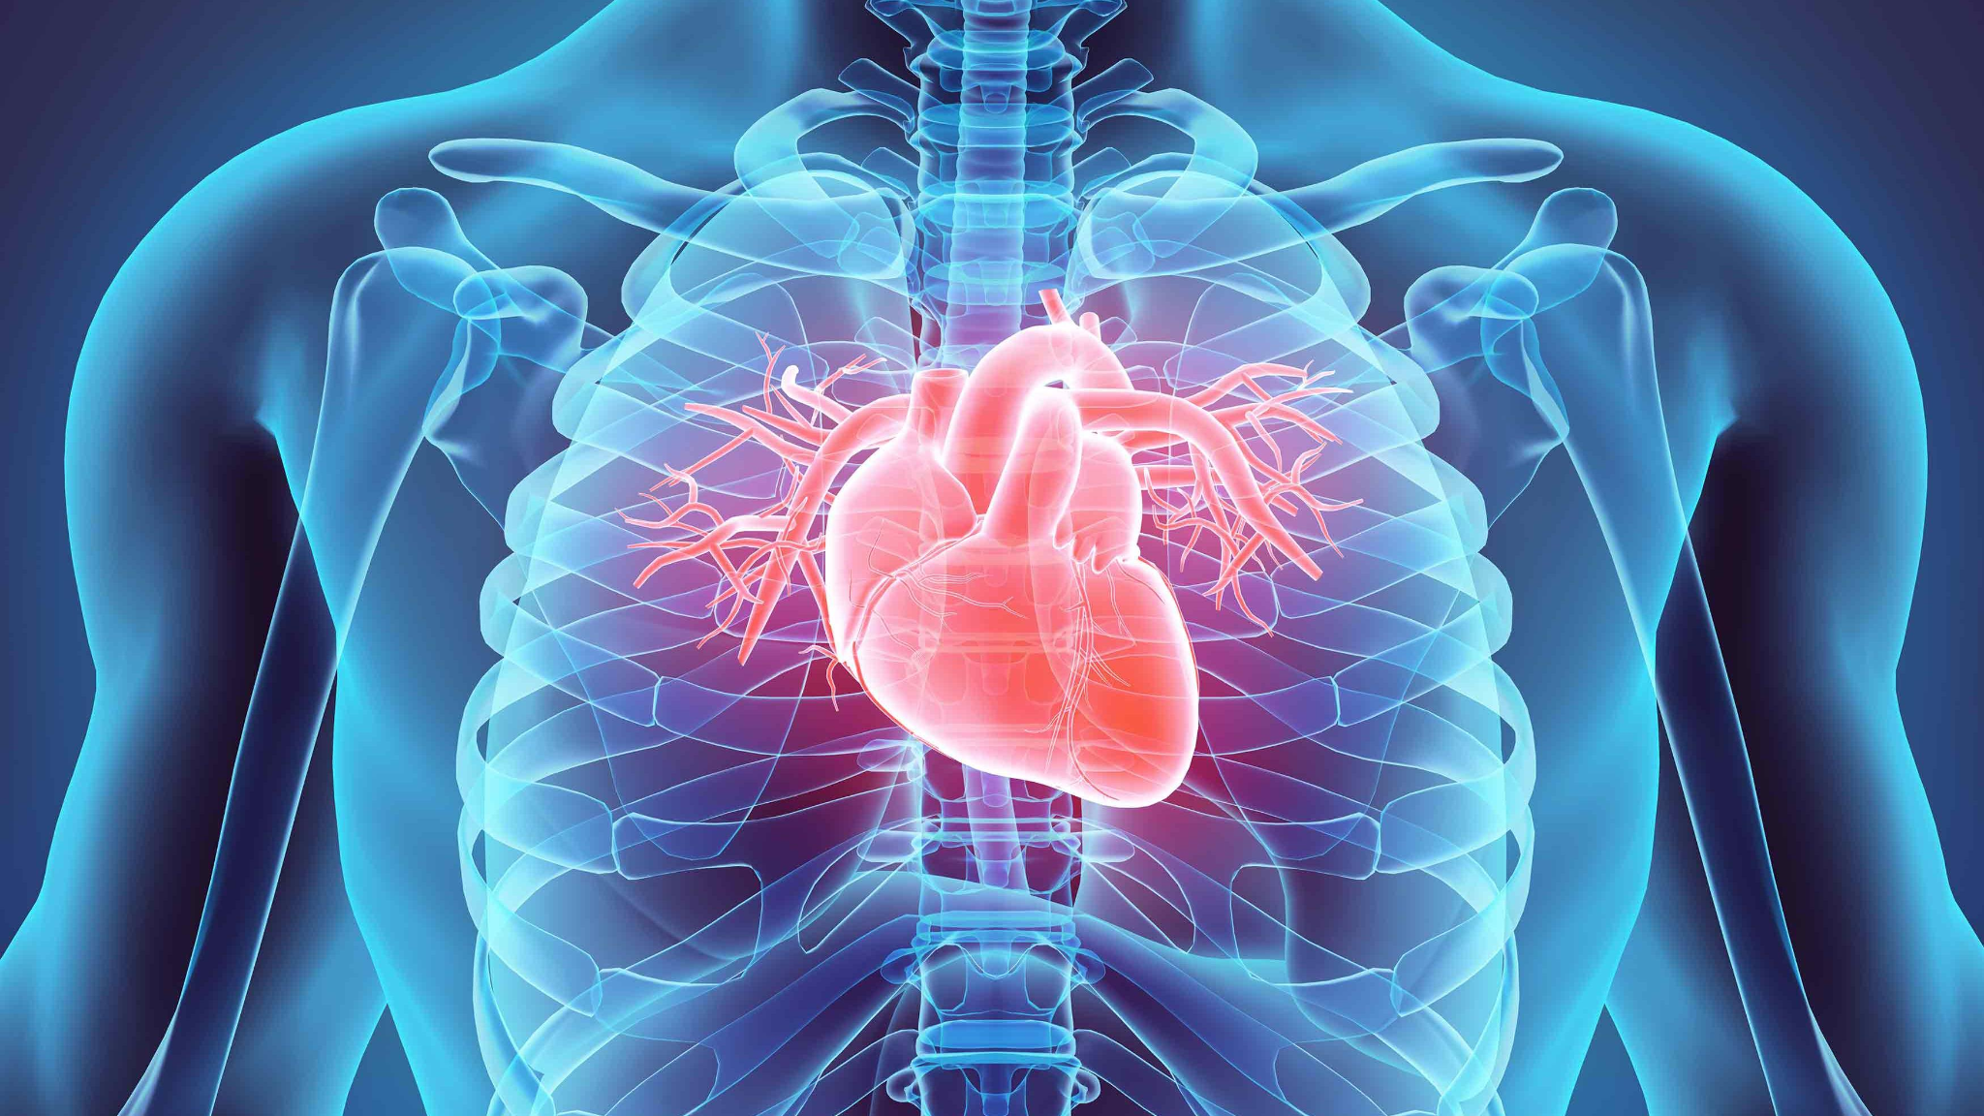
Questions?

